Slide 1

Master Thesis Defense
Automatic Image Colorization Using Semantic Guides
Committee: Prof. Name 1
Prof. Name 2
Advisor: Prof. Name
Presenter:
September 29st, 2025

Slide 2
Agenda
Introduction
Related Works
Proposed Methods
Experiments and Discussion
Conclusion
2

Slide 3
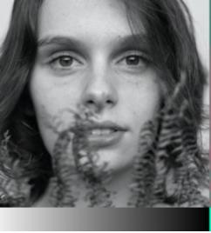
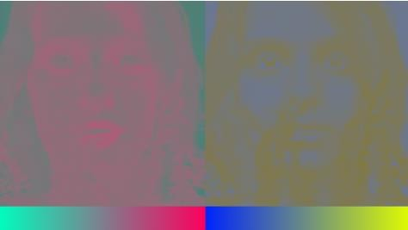
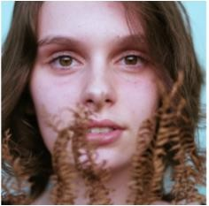
1. INTRODUCTION
Problem: Fully Automatic Colorization
Given the grayscale image, produce a plausible colorization to fool a human
observer.
Input: Grayscale image or L channel of image, output ab channel of image
L
a
b

Slide 4
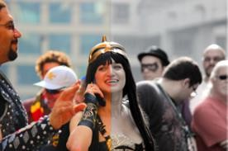
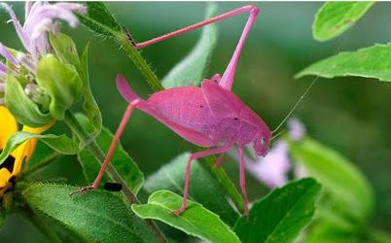
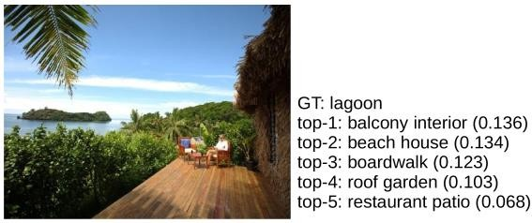
1. INTRODUCTION
전남대학교 인공지능융합학과
Challenges of Fully Automatic Colorization:
Averaging effect: grayish, desaturated results due to 94% of the cells in our eyes determine brightness, only 6% for colors. Grayscale image is a lot sharper than the color layers.
Rare colors in images: strongly biased due to the appearance of backgrounds such as clouds, pavement, dirt, and walls.
Semantic information matters: In order to colorize any kind of image, a system must interpret the semantic composition of the scene (what is in the image: faces, cars, plants,
. . . ) as well as localize objects (where things
are).

Slide 5
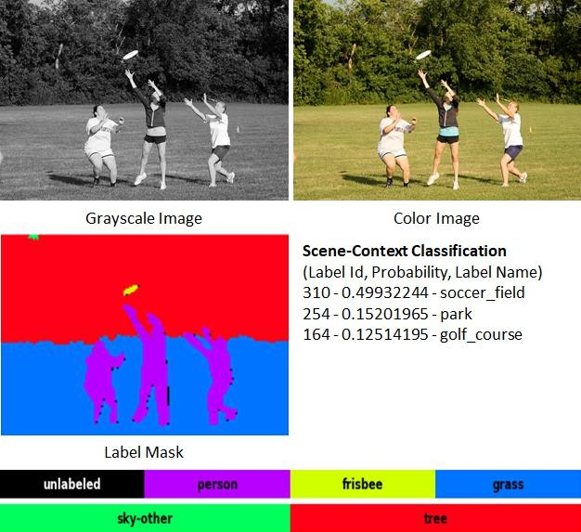




1. INTRODUCTION
전남대학교 인공지능융합학과
Objectives:
– Integrate scene-context classification and pixel-wise semantic segmentation
scene-context classification
+ global scene information
Scene-context classes (totally 365 classes)
pixel-wise semantic segmentation
+ what object the pixels belong to
Segmentation classes in Coco-Stuff
(0: unlabeld, 1 – 182: objects & stuffes)

Slide 6



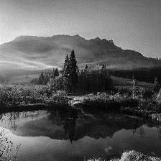
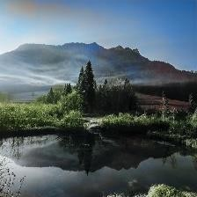
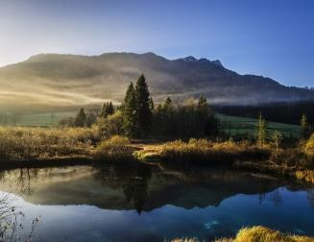

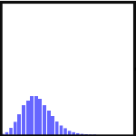

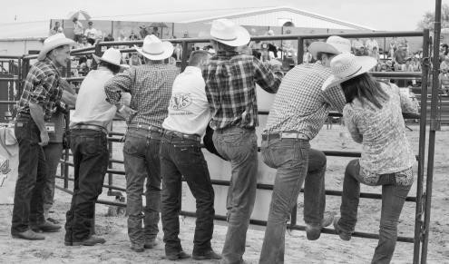
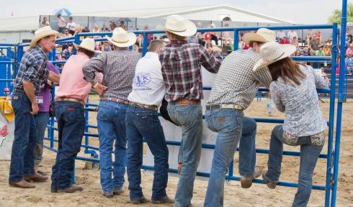







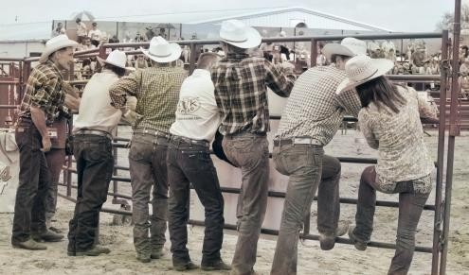
1. INTRODUCTION
전남대학교 인공지능융합학과
Objectives:
– Use ab color distribution to encourage rare color (rebalancing colors), and multi-
modal in colorization
With a pixel
Tree
Sky (common colors)
GT
Gray
Ours
0
n-1
Gray
GT
ab color distribution
vs.
ab color value
Shirt (diversity colors, rare colors)
Multi-Modal Attribute or Bias (many choice in colorization) leading to
Grayish or Desaturated Effect
Grayish result

Slide 7
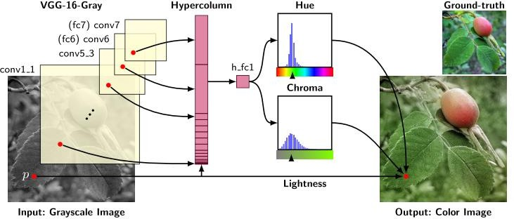
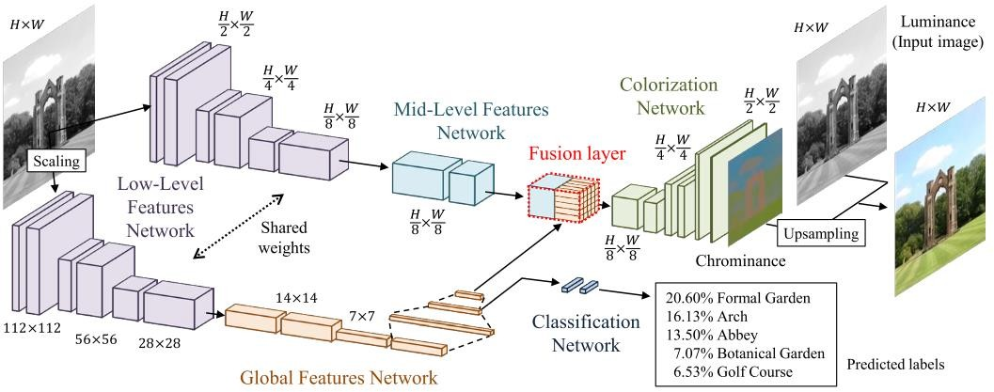
2. RELATED WORKS
전남대학교 인공지능융합학과
Larsson et al.¹: use un-rebalanced classification loss, build on hyper-columns on a VGG network, train on ImageNet, evaluate on PSNR, RMSE.
Iizuka et al.²: use a regression loss, build a two-stream architecture fusing
global and local features, train on Places365 scene dataset.
Regression
Classification
Larsson et al. Iizuka et al.
G. Larsson, M. Maire, and G. Shakhnarovich, “Learning Representations for Automatic Colorization,” in Lecture Notes in Computer Science (including subseries Lecture Notes in Artificial Intelligence and Lecture Notes in Bioinformatics), vol. 9908 LNCS, 2016, pp. 577–593.
S. Iizuka, E. Simo-Serra, and H. Ishikawa, “Let there be Color: Joint End-to-end Learning of Global and Local Image Priors for Automatic Image Colorization with Simultaneous Classificatio,” ACM Transactions on Graphics, vol. 35, no. 4, pp. 1–11, Jul. 2016.

Slide 8
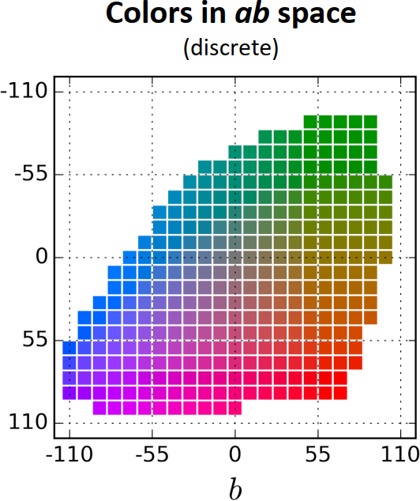
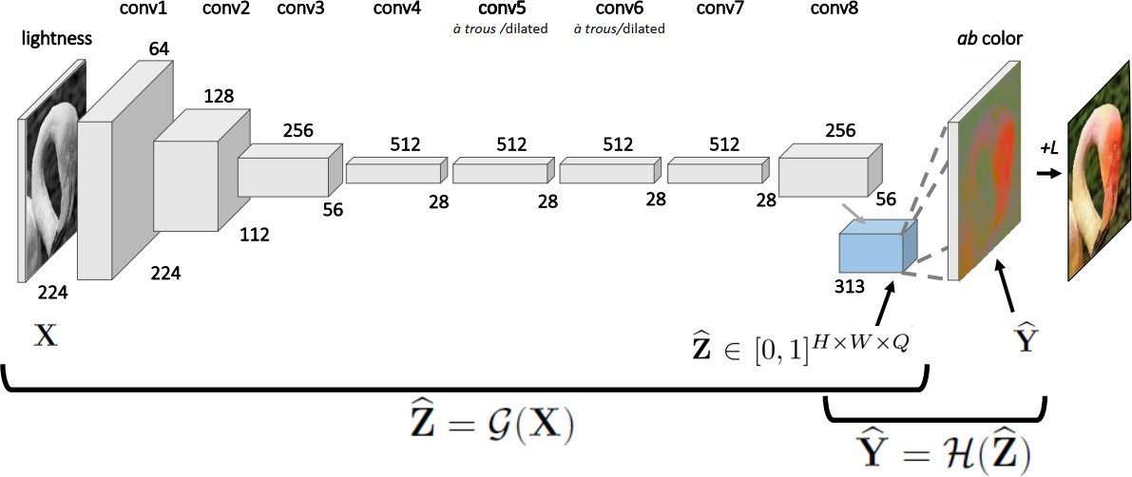
2. RELATED WORKS
전남대학교 인공지능융합학과
Zhang et. at¹
Multi-Class Classification problem by quantize ab space into grid size 10, keep
313 bins in gamut.
Category cross entropy loss with class rebalancing to encourage learning of rare colors.
quantize ab space with grid size 10 (313 bins)
Deep network model
[1] R. Zhang, P. Isola, and A. A. Efros,Colorful Image Colorization, ECCV, pp. 649–666, 2016

Slide 9
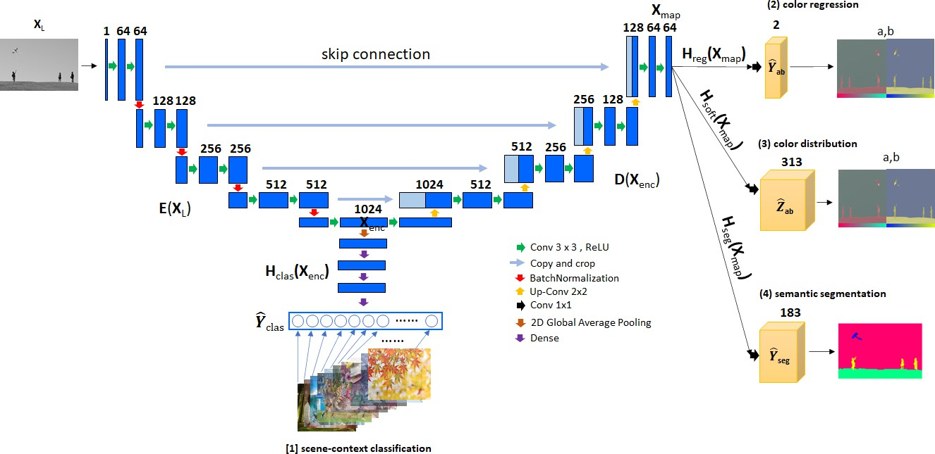


3. PROPOSED METHOD
전남대학교 인공지능융합학과
Our Model: Main Idea
Take advantage of skip connections between the contracting and expanding path at the same depth level using U-Net model (prevent dying ReLU and vanishing problem¹)
Use multi-task learning with end-end training from gray-scale image to four outputs for learning mutual benefits of global/local context, content accuracy and color biases.
decoding feature map
(W x H x 64)
Input image
(224 x 224 x 1)
W x H x 2
Content accuracy (grayish effects)
encoding features (7x7x1024)
W x H x 313
flexible colorize for rare
color
365
W x H x 183
Global-style context from
Scene Types of Places365
Local context at pixel-level with 183 objects and stuffes from Coco-Stuff
Semantic Image Colorization U-Net Model
[1] Douglas et al., “Why RELU Units Sometimes Die: Analysis of Single-Unit Error Backpropagation in Neural Networks,” In 2018 52nd
Asilomar Conference on Signals, Systems, and Computers, pp. 864-868, 2018
9

Slide 10
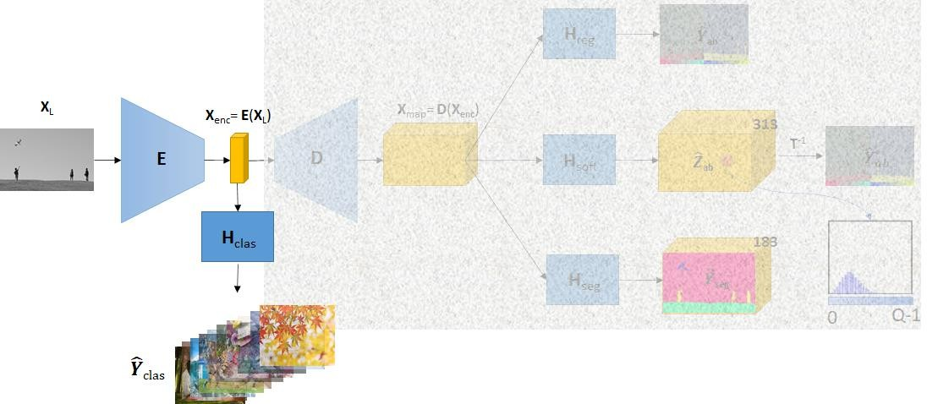
3. PROPOSED METHOD
전남대학교 인공지능융합학과
Explanation Details: Classification Branch
Compute backward gradient of the classification loss to enhance encoding feature X_{enc} and
Encoder Block E with scene global-style during training process
Create scene label ground-truth for training data:
use pre-train weights VGG16 on Places365 Dataset to predict scene labels
apply label smoothing technique
Learning global-style

Slide 11
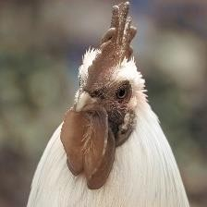
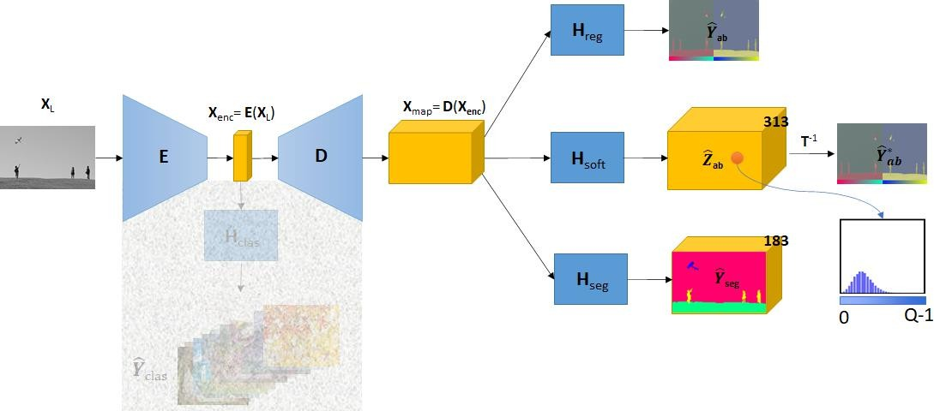
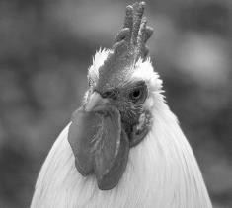
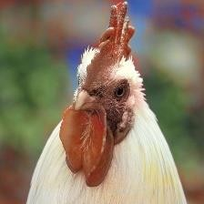
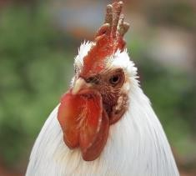
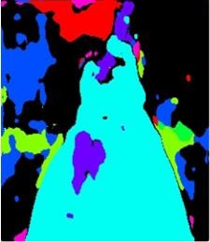
3. PROPOSED METHOD
전남대학교 인공지능융합학과
Explanation Details: Regression/Color Distribution/Segmentation Branches
Compute backward gradients of three branches to enhance decoding feature map X_{map} and encoding feature X_{enc}
regression branch to keep the accuracy between prediction/ground-truth → output results with grayish and desaturated effects (not used as colorized result)
color distribution branch to encourage rare color (rebalancing colors) and multi-modal
in colorization →
output results with more vivid
segmentation branch to help the system understand what object the pixels belong to
(with 183 object & stuff labels) →
output results with more precise edge
Gray
Reg
Soft
colorize result
Learning mutual benefits at pixel-level
Ground-Truth
Seg

Slide 12
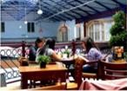



3. PROPOSED METHOD
전남대학교 인공지능융합학과
More details: The scene-context classification:
– Extract the scene probabilities of training dataset (without scene-context ground-
truth) based on pre-trained model on Places365¹.
Pre-trained Model
0 | 1 | 2 | 3 | … | n-1
Scene probability with n=365
Image
– Label Smoothing² with top-5 prediction: keep 5 highest probabilities, set all remain values to 0, and normalize the probabilities with sum 1.
Top-1: Cafeteria (0.179)
Top-2: Restaurant (0.167)
Top-3: dining_hall (0.091)
Top-4: coffe_shop (0.086)
Top-5: restaurant_patio (0.080)
Top-1: Cafeteria (0.297)
Top-2: Restaurant (0.277)
Top-3: dining_hall (0.151)
Top-4: coffe_shop (0.143)
Top-5: restaurant_patio (0.132)
B. Zhou, A. Lapedriza, A. Khosla, A. Oliva, and A. Torralba, “Places: A 10 Million Image Database for Scene Recognition,” IEEE transactions on pattern analysis and machine
intelligence (TPAMI), vol. 40, no. 6, pp. 1452–1464, 2018
R. Müller, S. Kornblith, and G. Hinton, “When Does Label Smoothing Help?,” In Advances in Neural Information Processing Systems (NeurIPS), pp.4696-4705, 2019.

Slide 13
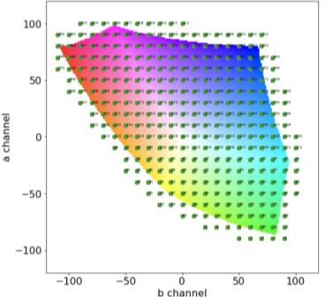
3. PROPOSED METHOD
전남대학교 인공지능융합학과
More details: The ab color distribution
Soft-Encoding Process:
Step 1: For every pixel of image, convert from ab values to color index q (encoding)
using K-Nearest
^{𝐼}𝑎𝑏
𝑝 = (𝑎, 𝑏)
q ∈ [0,312]
Step 2: Convert to one-hot encoding representation
0 … 312
q
Step 3: Apply label smoothing
– Use K-Nearest neighbors to get 4 color indexes nearest q,
quantize ab space with grid size 10 (313 bins)
 | … | 0 | 0 | 1 | 0 | 0 | …
– Generate 5 gaussian values, and normalize
0 …
312
 | … | 0.05 | 0.24 | 0.42 | 0.24 | 0.05 | …
q
0
n-1

Slide 14
3. PROPOSED METHOD
전남대학교 인공지능융합학과
Multi-Task Losses:
^{ℒ}𝑡𝑜𝑡𝑎𝑙 ^{= 𝑤}𝑠𝑜𝑓𝑡^{ℒ}𝑠𝑜𝑓𝑡 ^{+ 𝑤}𝑐𝑙𝑎𝑠 ^{ℒ}𝑐𝑙𝑎𝑠 ^{+ 𝑤}𝑠𝑒𝑔 ^{ℒ}𝑠𝑒𝑔^{+ 𝑤}𝑟𝑒𝑔 ^{ℒ}𝑟𝑒𝑔
– Pixel Classification of ab color distribution: Weighted Category Cross-Entropy Loss:
𝑁
^{ℒ}𝑠𝑜𝑓𝑡
𝑦, 𝑦ෝ
= − ෍ 𝑣 𝑦_{ℎ,𝑤}
ℎ,𝑤
෍ ^{𝑦}ℎ,𝑤,𝑖 ^{log 𝑦ෝ}ℎ,𝑤,𝑖
𝑖=1
Where N is the number of quantized colors of ab color distribution, 𝑣 𝑦_{ℎ,𝑤} is the weighted of
is the ground-
color-classs at pixel (h,w) to encourage the rare-color,
^{𝑦}ℎ,𝑤,𝑖 ^{/ 𝑦ො}ℎ,𝑤,𝑖
truth/prediction probability of the soft-encoding color i at pixel (h,w).
– Scene-context classification: Category Cross-Entropy (CCE) loss:
𝐶
^{ℒ}𝑐𝑙𝑎𝑠
𝑦, 𝑦ෝ
= − ෍ 𝑦_{𝑖} log 𝑦ෝ_{𝑖}
𝑖=1
Where C is the number of scene, y_{i}/ 𝑦ො_{𝑖} is the ground-truth/predicted scene probability.
– Pixel-wise sematic segmentation: Dice loss:
2 σ_{𝑝} 𝑦𝑦ො
^{ℒ}𝑠𝑒𝑔
𝑦, 𝑦ො = 1 −
2 2
σ_{𝑝} 𝑦 + σ_{𝑝} 𝑦ො
– Regression ab channel: Using Mean Square Error (MSE) Loss:
1
෍ 𝑦 − 𝑦ො
ℎ,𝑤
2
2
ℒ 𝑦, 𝑦ෝ =
𝑟𝑒𝑔
2ℎ𝑤

Slide 15
4. EXPERIMENTS AND DISCUSSION
전남대학교 인공지능융합학과
Training, Validation and Testing Datasets:
Method | Training | Validation | Testing
COCO-Stuff [1] | 118000 | 5000 | 1000 (ctest1k)
Places365 [2] |  |  | 1000 (ctest1k)
DIV2K [3] |  |  | 100 (high-resolution)
ImageNet [4] |  |  | 1000 (ctest1k)
Caesar, J. Uijlings, and V. Ferrari, “COCO-Stuff: Thing and StuffClasses in Context,”Proceedings of the IEEE Computer Society Confer-
ence on Computer Vision and Pattern Recognition, pp. 1209–1218, 2018.
B. Zhou, A. Lapedriza, A. Khosla, A. Oliva, and A. Torralba, “Places: A10 Million Image Database for Scene Recognition,”IEEE
Transactions onPattern Analysis and Machine Intelligence, vol. 40, no. 6, pp. 1452–1464,2018.
E. Agustsson and R. Timofte, “NTIRE 2017 Challenge on Single ImageSuper-Resolution: Dataset and Study,” inThe IEEE Conference
on Com-puter Vision and Pattern Recognition (CVPR) Workshops, jul 2017.
Jia Deng, Wei Dong, R. Socher, Li-Jia Li, Kai Li, and Li Fei-Fei,“ImageNet: A large-scale hierarchical image database,” in2009
IEEEConference on Computer Vision and Pattern Recognition.IEEE, jun2009, pp. 248–255.
[1]

Slide 16
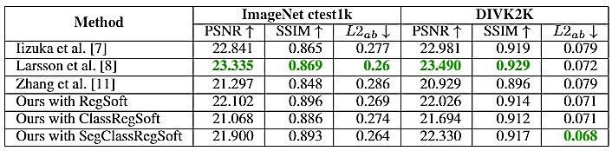

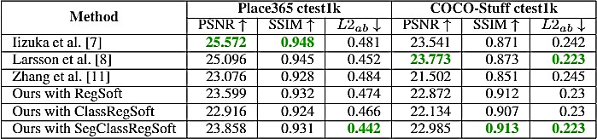


4. EXPERIMENTS AND DISCUSSION
전남대학교 인공지능융합학과
Quantitative comparisons:
Larsson et al.: better on PSNR for ImageNet,DIV2K, and COCO-Stuff and on SSIM results for ImageNet and DIV2K.
Our methods: better on L2_{ab} metric for DIV2K, Places365, and COCO-Stuff
Semantic segmentation played an important role in enhancing the colorization results, and it helped our method improve the accuracy of the ab channels.
[1]
[t]

Slide 17
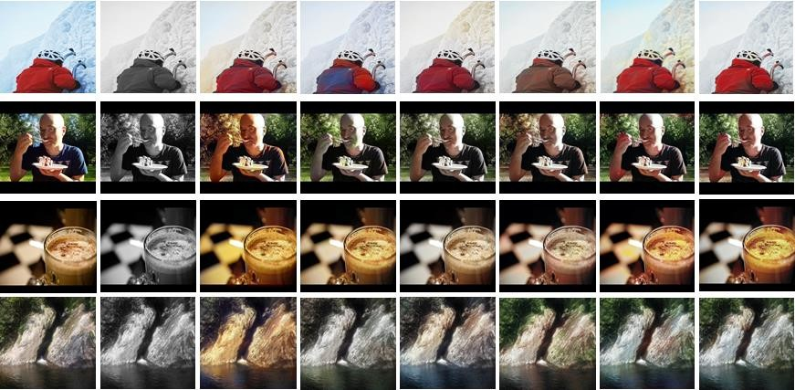
4. EXPERIMENTS AND DISCUSSION
전남대학교 인공지능융합학과
SUCCESSFUL CASES
Ground-truth Input Zhang Iizuka Larsson RegSoft ClasRegSoft
SegClasRegSoft
Div2k
Coco-Stuff
ImageNet
Places365
My results were more vibrant and had more precise edges than the other methods. Moreover, the yellow color noise also was reduced in our ClasRegSoft versions comparison on RegSoft version.

Slide 18
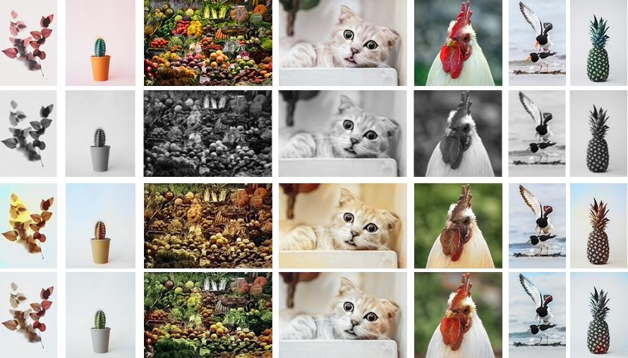
4. EXPERIMENTS AND DISCUSSION
전남대학교 인공지능융합학과
IMAGES FROM INTERNET
Ground truth
Input
Zhang
Ours

Slide 19
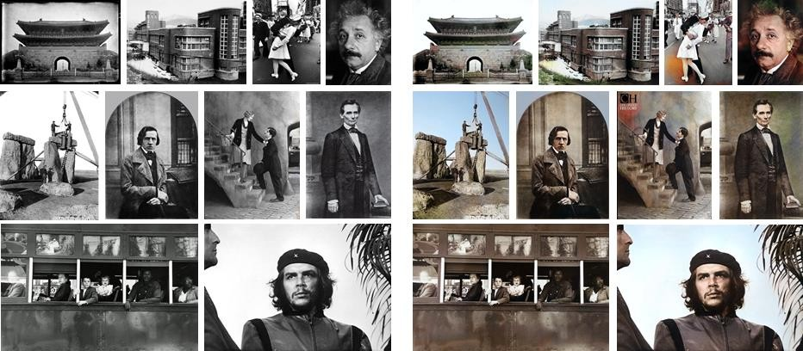
4. EXPERIMENTS AND DISCUSSION
전남대학교 인공지능융합학과
LEGACY IMAGES FROM INTERNET
Input Ours

Slide 20
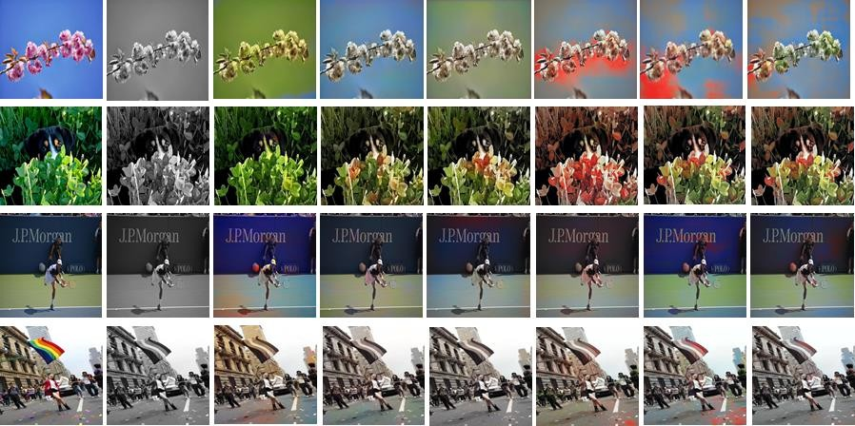
4. EXPERIMENTS AND DISCUSSION
전남대학교 인공지능융합학과
SOME FAIL CASES
Ground-truth Input Zhang Iizuka Larsson RegSoft ClasRegSoft
SegClasRegSoft
My results met difficulties for colorization with incorrect colors, noise occurrences. These defects are
similar to the results of Iizuka et al. and Larsson et al..

Slide 21

5. CONCLUSIONS
전남대학교 인공지능융합학과
I proposed the encoder-decoder architecture to deal with the global and local semantics in the colorization problem.
Our colorization model is the result of the mutual benefit learning of
scene-context classification branch to bring the global image style,
semantic segmentation branch at pixel-level of objects in scenes,
average colorization branch in the regression branch and
color distribution branch in a soft-encoding branch.
In the future, I will enhance the optimization process for multi-scale outputs to reduce noises. Moreover, I will use GANs model to colorize images better and get high resolution.
Published Paper: “Image colorization using the global scene-context style and pixel-wise semantic segmentation, ” IEEE Access 11/2020 (IF: 3.745), link: https://ieeexplore.ieee.org/document/9272287

Slide 22


THANK YOU FOR LISTENING
전남대학교 인공지능융합학과

